Slide 1



Analysis Report
View in Power BI
Last data refresh:
29/01/2024 05:50:57 UTC
Downloaded at:
29/01/2024 05:56:42 UTC

Slide 2
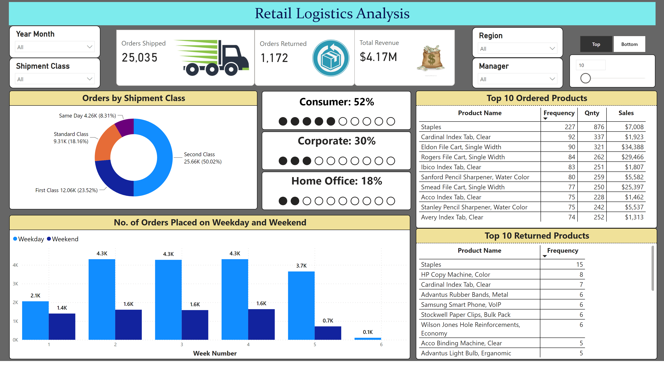
Retail Analysis
Notes:
cardVisual
No alt text provided
cardVisual
No alt text provided
cardVisual
No alt text provided
YearMonth
No alt text provided
Shioment
No alt text provided
Orders by Shipment Class
No alt text provided
No. of Orders Placed on Weekday and Weekend
No alt text provided
textbox
No alt text provided
Top 10 Ordered Products
No alt text provided
slicer
No alt text provided
slicer
No alt text provided
Top 10 Returned Products
No alt text provided
card
No alt text provided
Corporate: 30%
No alt text provided
Home Office: 18%
No alt text provided
Shioment
No alt text provided
Shioment
No alt text provided

